Slide 1
Summer 2019
Lakhveer Kaur

Slide 2
COOKBOOKS
Link to my GitHub Account: https://github.com/kaurlakhveer5/Python
Notes:
https://nbviewer.jupyter.org/ if github is not working
new Events endpoint
Find an ID and ready to proceed with different varaibles
Used 4 GCM’s, two climate variables and 5 cities

Slide 3
Regional heat events
Days where Tmax is higher than 90th percentile of historic temperature in all six population centers
- Location: Sacramento, San Diego, Los Angles, Santa Barbara, Fresno, San Jose
- Model: CanESM2
- Scenario: RCP 8.5
- Historical Time Period: 1961-1990
Notes:
Find the 90th percentile of historic data (1961-1990) in all 5 cities (90th percentile of 30 year data)
Find all the days is every city which has temperature higher than its corresponding 90th percentile historic value
Keep only the days that are common in all cities.
Take average of temp in all cities
Plot these days on a graph

Slide 4
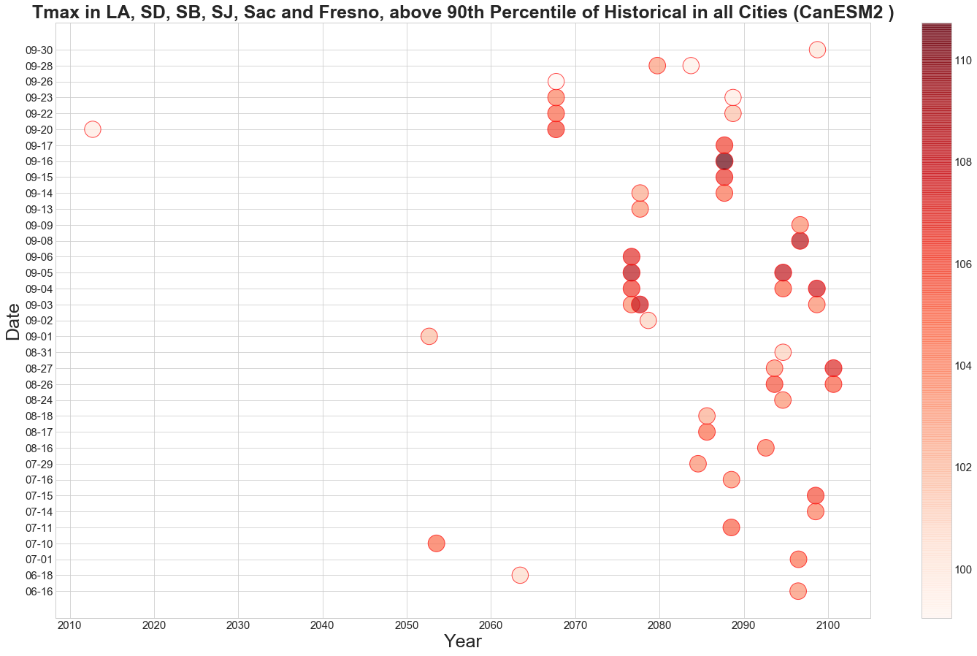
Notes:
each bubble is a day which meets the above requirements (tmax is higher than 90th percentile of historic values in each city). Color shows the average of max temperature in all six locations on that specific day. Darker the color is, higher the temperature is on that day. High temp is from Mid June to Late Sept
Prior to 2010, there is no such events when temp was above histocial 90th in all six populated areas

Slide 5
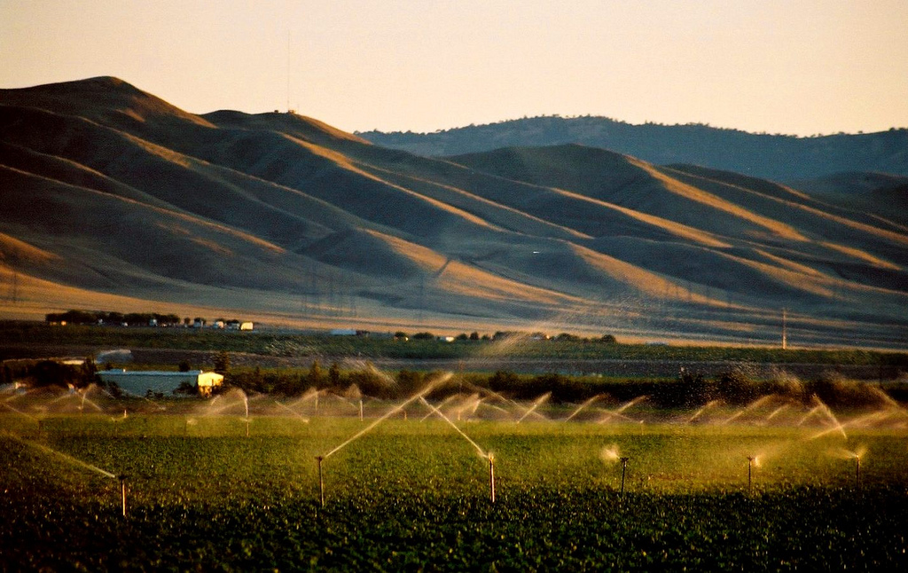
Cumulative distribution
Variables:
- LOCA gridded data in San Joaquin Valley
- Daily Tmax (July)
- 10 Priority Models (Stacked Data)
- RCP 8.5
- Time Period
- Historical: 1961-1990
- Projected: 2021-2050
This work replicate Guido Franco’s report “PROBABILISTIC” CLIMATE PROJECTIONS FOR CALIFORNIA
Notes:
plot cumulative probabilistic distribution for both historical and projected data on the same graph.
It allows us to see how distribution of daily max temperature is going to change in future compare to historical years.

Slide 6
Frequency distribution
- Min Temp: 73.6 F (From entire data set)
- Max temp: 119F (From entire data set)
- Categorize the data in 92 bins [73.5 – 119]
- calculate relative frequency of each bin
- Find Cumulative Frequency using Relative Frequency
Notes:
Computing everything simultaneously on Historical and Projected Data
0.5 interval
The relative frequency of each bin is the percentage of data element in that bin.
find the cumulative frequency (running total of frequencies)

Slide 7
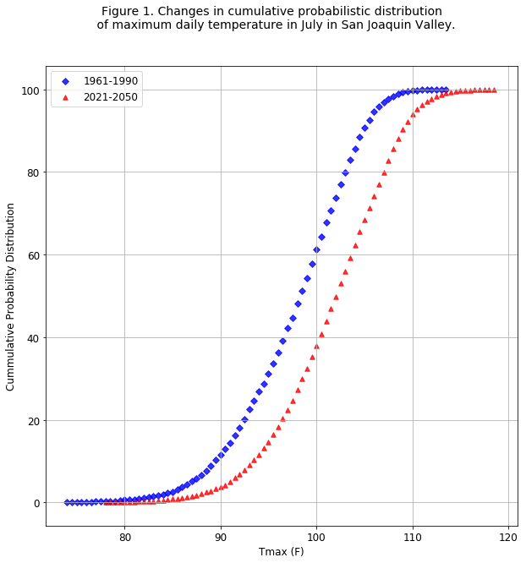
Notes:
In this graph, blue diamonds represent the cumulative distribution of historical daily tmax and red triangles represent cumulative distribution of projected daily tmax. This shows that how daily tmax is going to be increased in Future yeras
For example, by looking at the x-axis, 100 was above 60th percentile in historical period, but it is below 40th percentile of projected tmax. Vertical gap in two curves show the percentile difference.
For a given temperature, the vertical gap shows how its percentile “ranking” changes. The horizontal gap shows the change in temperature for a given percentile.

Slide 8
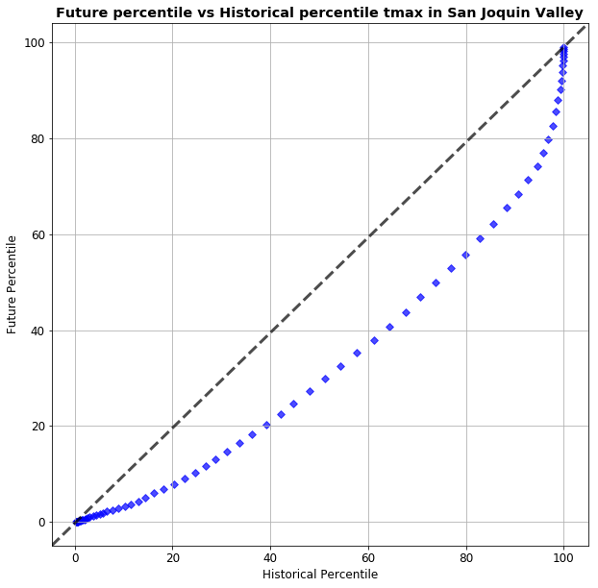
Temp: 104.5 F
Hist %tile: 88th
Proj %tile: 65th
Notes:
In this graph, we compare the shapes of distribution to find how daily tmax percentiles are different or similar in historical and projected period. If both distributions were similar, the plot would lie on black dashed y = x line.
Each diamond (bubble) represents a given temperature (e.g., 104.5 deg is the 88th percentile in the historical distribution, then 65th percentile in the future distribution

Slide 9
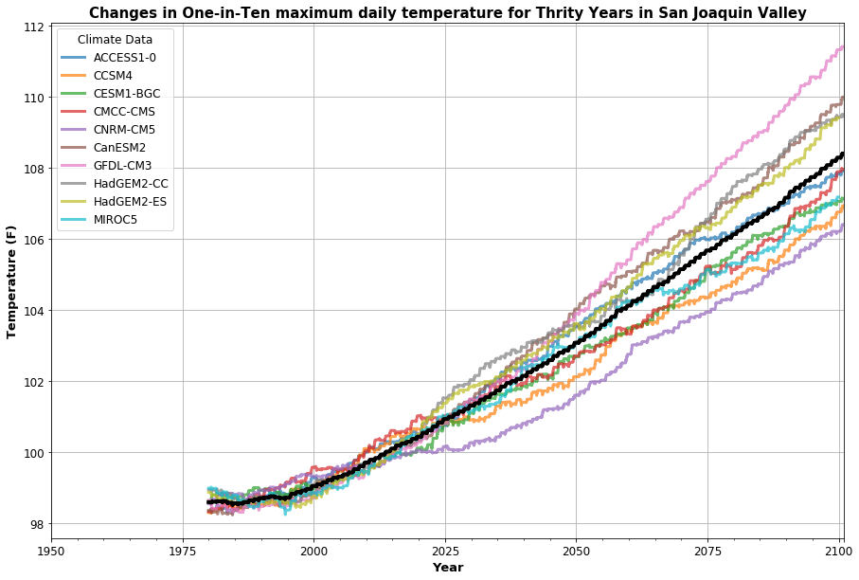
Notes:
1 in 10 is equivalent to 90th percentile of events. Graph shows the running 90th percentile of past thirty years for each model. Black curve in the graph is the average of all 10 GCM’s. By looking only at average curve, we can see a large change in 90th percentile as we move from beginning of the century to end of the century. GFDL is the hottest model where CNRM-CM5 is the least hot one.
Running 90th percentile of past thirty years.

Slide 10
Fire conditions probability
Conditions Reported in Balch et al., 2018.
Conditions:
Upper tercile for precipitation from Oct of the prior year to April
Top decile of temperature from May to September
Bottom decile of precipitation from Sept to December
Extremely hot Oct to December (OND) period (98th percentile or higher)
Terciles, deciles, and percentiles were calculated from the 1961 to 1990 baseline period
Notes:
California fires have been very destructive in recent years. In this analysis, we observe the change in frequency of different events, which might lead to fires. For example, high precipitation in one year lead by very hot temperature in next year. We used the conditions that were originally specified in Balch et al., 2018.

Slide 11
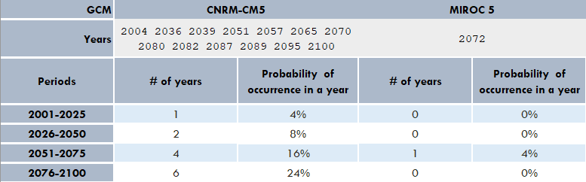
Probability of FIRe conditions

Slide 12
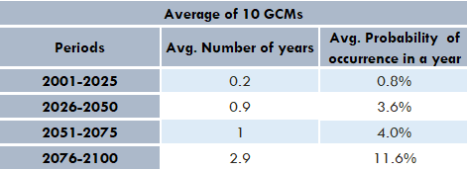
Probability of fire conditions

Slide 13
Onset winter precipitation
The day when precipitation reaches 10% of the average of historical yearly aggregated precipitation
Step 1. To calculate the threshold, we aggregated the precipitation by year for historical time period (1961-1990). Then took the average of aggregated precipitation data (30 values) and calculated 10% of the average.
Step2. Calculated the running total of precipitation by year, and found the day when running total hits the threshold.
Note: Calculations are based upon water year (Oct – Sep)
This analysis is inspired by Williams’s analysis in “Observed Impacts of Anthropogenic Climate Changeon Wildfire in California”

Slide 14
Onset winter precipitation
Variables:
- LOCA gridded data in Paradise
- Daily precipitation data
- GCMs: CNRM-CM5 & MIROC 5
- Rcp 8.5
- Units: mm/day
Threshold:
CNRM-CM5: 131.13mm
MIROC5: 138.08mm
Notes:
Take 10% of full year precipitation (Oct to September)

Slide 15
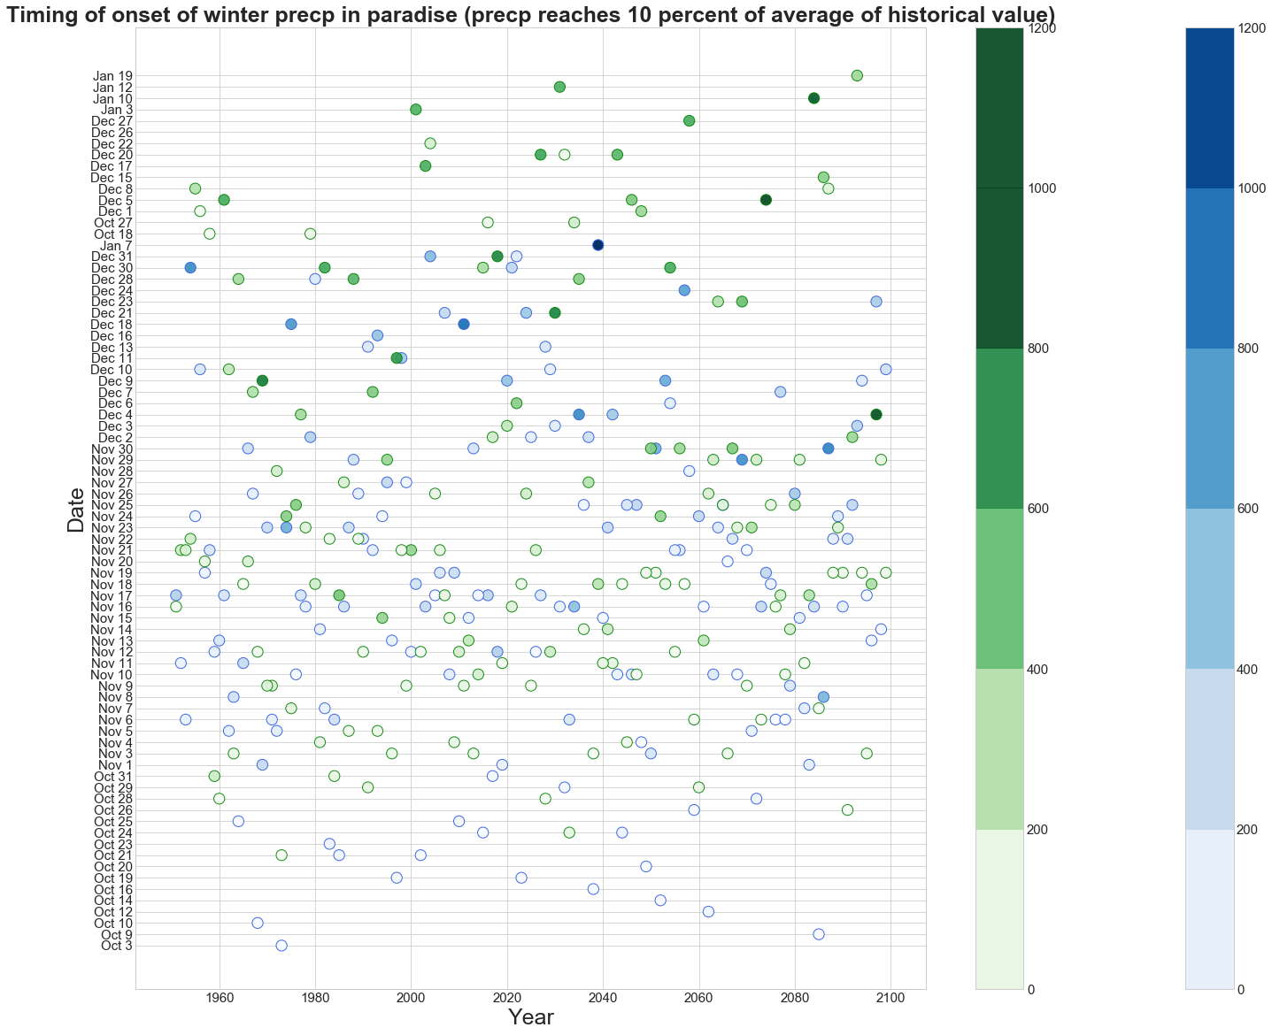
Green: MIROC5
Blue: CanESM-CM5
Notes:
Onset is going to reach in January later in century

Slide 16
Wet day frequency
Wet Day frequency in Oct-Nov is defined as days when Precipitation is greater than 2.54mm

Slide 17
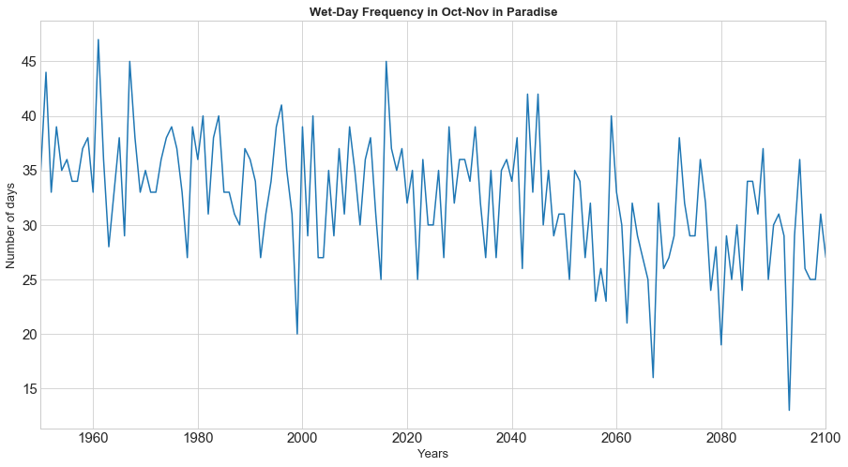
Notes:
Fewer “wet” days—at the same time that extreme precipitation events are generally more severe and more frequent—is what is projected by LOCA. Your graph shows the “fewer wet days” aspect of that.

Slide 18
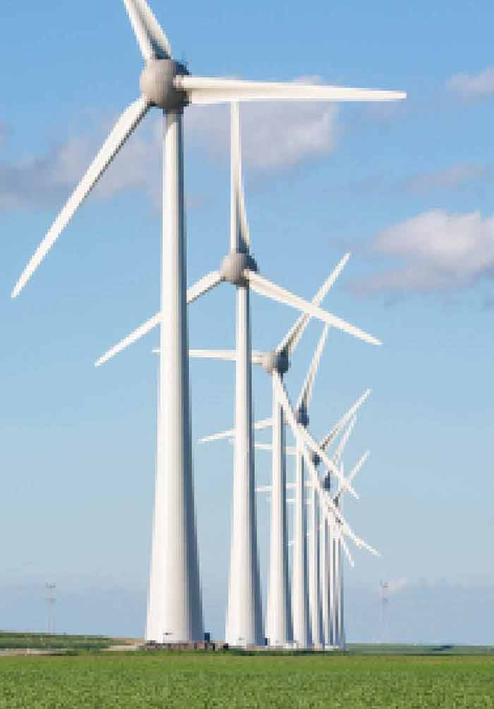
Wind Project
How wind-speed relates to the energy produced by Wind Turbines
Average Wind Speed per hour
Energy generated per hour by different turbines
manipulate different data sets to find the relative information
How trend changes later in the century
Notes:
I could not help but put this graph in here
Wind Energy is related to wind (m/s). We looked at the data from Altamont pass. This graph shows that

Slide 19
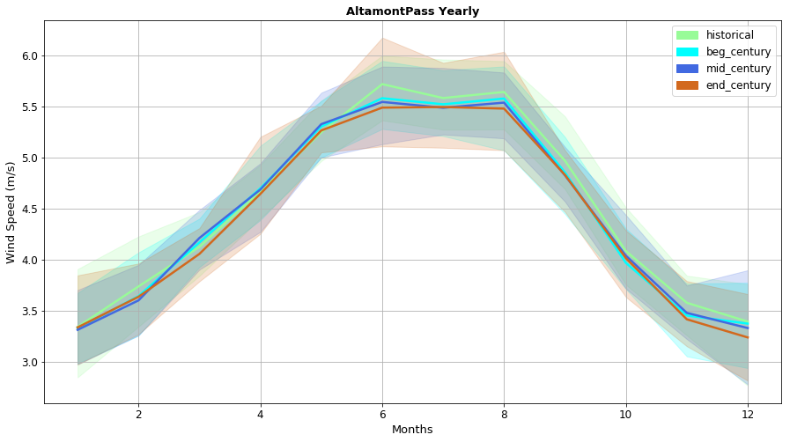
Notes:
Average daily wind speed
Daily Data from four priority models and averaged
Plotted Historical (1950-2005), Beg Century (2006-2034), Mid century (2035-2064), and End of century (2065-2099)
We can see that unlike daily temperature or precipitation, wind speed is not going to change much, and hence, we can expect the same wind energy production.

Slide 20
Google Colab
https://colab.research.google.com/notebooks/welcome.ipynb
1. Go to the above link and login with your google email.
2. Start Coding in Python OR
2. Upload the cookbook using file/upload notebook on the left side.

Slide 21
Citation
Williams, A. Park, et al. "Observed impacts of anthropogenic climate change on wildfire in California." Earth's Future (2019).

Slide 22
Thank You!

